Slide 1



chapter 1
the human

Slide 2
INPUT–OUTPUT CHANNELS Vision
Input in the human occurs mainly through the senses
Five major senses: sight, hearing, touch, taste and smell
Taste and smell do not currently play a significant role in HCI
Which sense is the most important of them?
Vision is undoubtedly the most important sense:
  It is very difficult to live without vision.
  It provides most of the data that we receive – megabits of data at each glance.
  It analyzes and interprets the whole scene effortlessly within a tenth of a second.
Notes:
we will first look at the human’s input–output channels, the senses and responders or effectors.
This will involve some low-level processing. Secondly, we will consider human memory and how it works. We will then think about how humans perform complex problem solving, how they learn and acquire skills, and
why they make mistakes. Finally, we will discuss how these things can help us in the design of computer systems.
Input in the human occurs mainly through the senses and output through the motor control of the effectors. There are five major senses: sight, hearing, touch, taste and smell. Of these, the first three are the most important to HCI. Taste and smell do not currently play a significant role in HCI

Slide 3
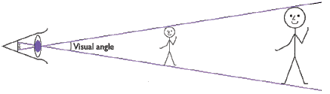
INPUT–OUTPUT CHANNELS Vision
  Visual angle indicates how much of view object occupies (relates to size and distance from eye)
    Objects of different sizes and different distances may have the same visual angle!
Notes:
Understanding the basic construction of the eye goes some way to explaining the physical mechanisms of vision but visual perception is more than this.
we will look a little more closely at how we perceive size and depth, brightness and color, each of which is crucial to the design of effective visual interfaces.
how does the eye perceive size, depth and relative distances? To understand this
we must consider how the image appears on the retina. As we noted in the previous
section, reflected light from the object forms an upside-down image on the retina.
The size of that image is specified as a visual angle. Figure 1.2 illustrates how the
visual angle is calculated.
The visual angle indicates how much of the field of view is taken by the object. The visual angle measurement is given in either degrees or minutes of arc, where 1 degree is equivalent to 60 minutes of arc, and 1 minute of arc to 60 seconds of arc.

Slide 4
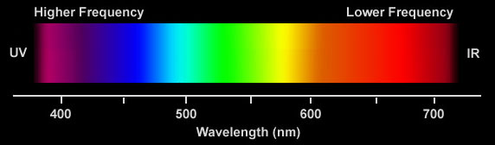
INPUT–OUTPUT CHANNELS Vision:
Color can be a powerful tool to improve user interfaces by communicating key information
Inappropriate use of color can severely reduce the performance of systems we build

Slide 5



INPUT–OUTPUT CHANNELS
Vision
Context is used to resolve ambiguity
Notes:
Visual processing compensates for the movement of the image on the retina which occurs as we move around and as the object which we see moves. Although the retinal image is moving, the image that we perceive is stable. Similarly, color and brightness of objects are perceived as constant, in spite of changes in luminance.

Slide 6


What’s below?

Slide 7
Demo

Slide 8
INPUT–OUTPUT CHANNELS
Vision:
  Negative contrast (dark characters on a light screen) improves reading from computer screen
Notes:
Contrast is the difference in luminance and /or color that makes an object (or its representation in an image or display) distinguishable.

Slide 9
INPUT–OUTPUT CHANNELS
Hearing
Provides information about environment:
distances, directions, objects etc.
Notes:
sound is changes or vibrations in air pressure
Low frequency produces low pitch
Speech is the verbal means of communicating. Speech consists of the following:
Articulation: How speech sounds are made (e.g., children must learn how to produce the "r" sound in order to say "rabbit" instead of "wabbit").
Voice: Use of the vocal folds and breathing to produce sound (e.g., the voice can be abused from overuse or misuse and can lead to hoarseness or loss of voice).
FluencyThe rhythm of speech (e.g., hesitations or stuttering can affect fluency).

Slide 10
INPUT–OUTPUT CHANNELS
Hearing (cont)
Humans can hear frequencies from 20Hz to 15kHz
Auditory system filters sounds
  can attend to sounds over background noise.
  for example,
    where we can pick out our name spoken across a crowded noisy room.
  However, if sounds are too loud, or frequencies too similar, we are unable to differentiate sound
sound can convey a remarkable amount of information
  Warning sounds and notifications

Slide 11
INPUT–OUTPUT CHANNELS
Touch or haptic
Provides important feedback about environment.
May be key sense for someone who is visually impaired.
Some areas more sensitive than others e.g.
fingers
Notes:
TouchCity

Slide 12
Memory
There are three types of memory function:
Sensory memories
Short-term memory or working memory
Long-term memory
Attention
Rehearsal

Slide 13
sensory memory
Buffers for stimuli received through senses
  iconic memory: visual stimuli
  echoic memory: aural stimuli
  haptic memory: tactile stimuli
Continuously overwritten

Slide 14
Short-term memory (STM)
  limited capacity - 7± 2 chunks

Slide 15
Examples
265397620853
212348278493202
0121 414 2626
HEC ATR ANU PTH ETR EET
The successful formation of a chunk is known as closure

Slide 16
Long-term memory (LTM)
Repository for all our knowledge
  slow access
  slow decay
  huge or unlimited capacity
Two types
  episodic – serial memory of events
  semantic – structured memory of facts, concepts, skills
  semantic LTM derived from episodic LTM

Slide 17
Long-term memory (cont.)
Semantic memory structure
  provides access to information
  represents relationships between bits of information
  supports inference
Model: semantic network
  inheritance – child nodes inherit properties of parent nodes
  relationships between bits of information explicit
  supports inference through inheritance

Slide 18
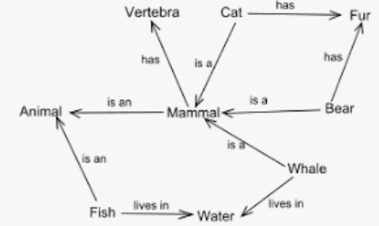
LTM - semantic network

Slide 19

LTM - semantic network

Slide 20
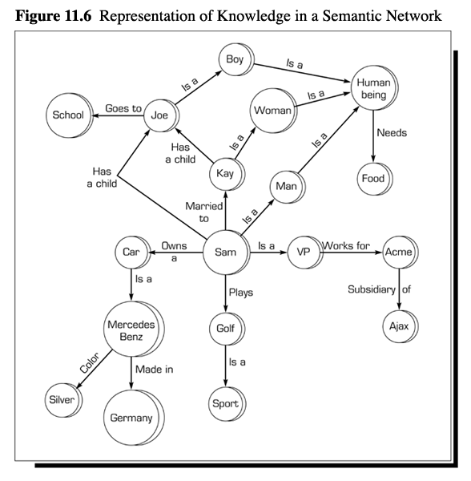
Semantic Networks

Slide 21
Models of LTM - Frames
Information organized in data structures
Slots in structure instantiated with values for instance of data
DOG
Fixed
legs: 4
Default
diet: carniverous
sound: bark
Variable
size:
colour

Slide 22
Models of LTM - Production rules
Condition/action rules
  if condition is matched
  then use rule to determine action.
IF dog is wagging tail
THEN pat dog
IF dog is growling
THEN run away

Slide 23
Thinking
Reasoning
deduction, induction, abduction
Problem solving

Slide 24
Deductive Reasoning
Deduction:
  derive logically necessary conclusion from given premises.
  e.g. If it is Friday then she will go to work
  It is Friday
  Therefore she will go to work.
Logical conclusion not necessarily true:
  e.g. If it is raining then the ground is dry
  It is raining
  Therefore the ground is dry
Often truth and logical validity clash …
Notes:
Monkeys like Bananas
Lucky is Monkey Lucky likes Bananas
Rule
Case
Result

Slide 25
Inductive Reasoning
Induction:
  generalize from cases seen to cases unseen
  e.g. all elephants we have seen have trunks
  therefore all elephants have trunks.
Notes:
Case
Result
Rule

Slide 26
Abductive reasoning
reasoning from event to cause
  e.g. Sam drives fast when drunk.
  If I see Sam driving fast, assume drunk.
Unreliable:
  can lead to false explanations

Slide 27
Problem solving
Process of finding solution to unfamiliar task using knowledge.
Several theories:

Slide 28
Classical Approach
The classical approach to solving a problem is pretty simple. Given a problem at hand, use hit and trial method to check for various solutions to that problem. This hit and trial approach usually works well for trivial problems and is referred to as the classical approach to problem solving.

Slide 29
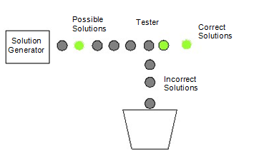
Generate and Test
This is a technical name given to the classical way of solving problems where we generate different combinations to solve our problem, and the one which solves the problem is taken as the correct solution. The rest of the combinations that we try are considered as incorrect solutions and hence are destroyed.

Slide 30
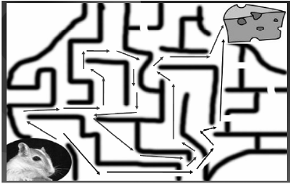
Problem solving (cont.)
Problem space theory
  problem space comprises problem states
  problem solving involves generating states using legal operators
  heuristics may be employed to select operators

Slide 31
Components of Problem Solving
They are namely:
Problem Statement,
Goal State,
Solution Space
and Operators.

Slide 32
Problem Statement
The two major things that we get to know about the problem is the Information about what is to be done and constraints to which our solution should comply.
For example, taking the same example of the mouse, problem statement will tell us things like, the mouse has to reach the cheese as soon as possible and in case it is unable to find a path within an hour, it might die of hunger.

Slide 33
Goal State
what should be the output of our procedure in order to solve the problem.
For example in the case of mouse, the ultimate aim is to reach the cheese. The state of world when mouse will be beside the cheese and probably eating it defines the aim. This state of world is also referred to as the Goal State or the state that represents the solution of the problem.

Slide 34
Solution Space
We have to go though a certain amount of states of nature to reach the solution.
For example when the mouse was in the lower left corner of the maze, represents a state i.e. the start state. When it was stuck in some corner of the maze represents a state. When it was stuck somewhere else represents another state When it was traveling on a path represents some other state and finally when it reaches the cheese represents a state called the goal state.
The set of the start state, the goal state and all the intermediate states constitutes something which is called a solution space.

Slide 35
Operators
The traveling inside a solution space requires something called as “operators”.
In case of the mouse example, turn left, turn right, go straight are the operators which help us travel inside the solution space.
In short the action that takes us from one state to the other is referred to as an operator.
So while solving a problem we should clearly know that what are the operators that we can use in order to reach the goal state from the starting state.
The sequence of these operators is actually the solution to our problem.

Slide 36
Problem solving (cont.)
Analogy
  analogical mapping:
    Similarities between the known domain and the new one are noted and
    operators from the known domain are transferred to the new one.

